Slide 1
Advanced Game Development
Final Project
Mark L. Short

Slide 2
Asteroids
Native C++ Windows Application
Graphics via OpenGL
Sound via DirectXTK for Audio
Keyboard & XBox Controller Support via Direct Input
Proto Graphics Engine ( Engine.lib )

Slide 3
Asteroids
Game World Physics
Zero Gravity
Zero Friction
Zero Angular Dampening
Zero Linear Dampening
Wrapping game world

Slide 4
Asteroids
Asteroid Polygon Generation
Given a radius R, serving as a polygon’s average radius, a series of N number of radii where generated in the range [R – R/3, R + R/3].
Then, using the center point of the polygon, a set of vertices were constructed using [radii_{n} * cos θ, radii_{n} * sin θ].
A random angular velocity was generated in the range [-90˚, 90˚]
A random direction was used for generating the initial linear velocity.
This set of vertices, angular velocity and linear velocity defined the initial characteristics of each asteroid.

Slide 5
Asteroids
Ship Physics
Linear velocity (LV) is modeled as a 2D displacement vector [x, y].
Updates to game location is calculated based on the Ship’s current LV.
Changes were made to the Ship’s LV based on keyboard & joystick inputs.
Joystick - a game magnitude can be determined based on the controller magnitude (i.e. angle of Left Stick).
Keyboard – a constant magnitude is used based on the keypress state ( W, Up ).
Thrust Vector (TV) is generated using this magnitude in the direction of the ship’s current orientation.
Ship’s linear velocity(LV) is updated as:
LV += TV

Slide 6
Asteroids
Collision Detection
Pairwise collision detection based on the following:
Current Set of Active Game Objects
Ship, Projectile, Small Asteroids, Medium Asteroids, Large Asteroids
Only 1 Ship can be active at a time
Construct a set of Pair-Wise collision candidates consisting of a set of [Object_{1,}Object₂] pairs
Pair-wise collision pruning
Asteroids cannot collide with other asteroids
Objects cannot collide with themselves
Ships and missiles cannot collide with each other.
Therefore, [Object₁ ε { Ship, Missile }, Object₂ ε { Small, Medium, Large Asteroids }
Object₁ v Object₂ collision determined using following algorithm (next slide)

Slide 7
Asteroids
Collision Detection Algorithm
Conventional circle detection collision algorithm
Collision = (D < R1 + R2)
However, D = sqrt( (X2 – X1)² + (Y2 – Y1)² )
Ouch!
R1
R2
D

Slide 8
Asteroids
Collision Detection Algorithm
Optimized collision detection algorithm using AABB instead.
Very fast, efficient
No multiplication, division or other complex operations used.
Is it exact? NO!
But close enough for Asteroid game purposes
R1
R2

Slide 9
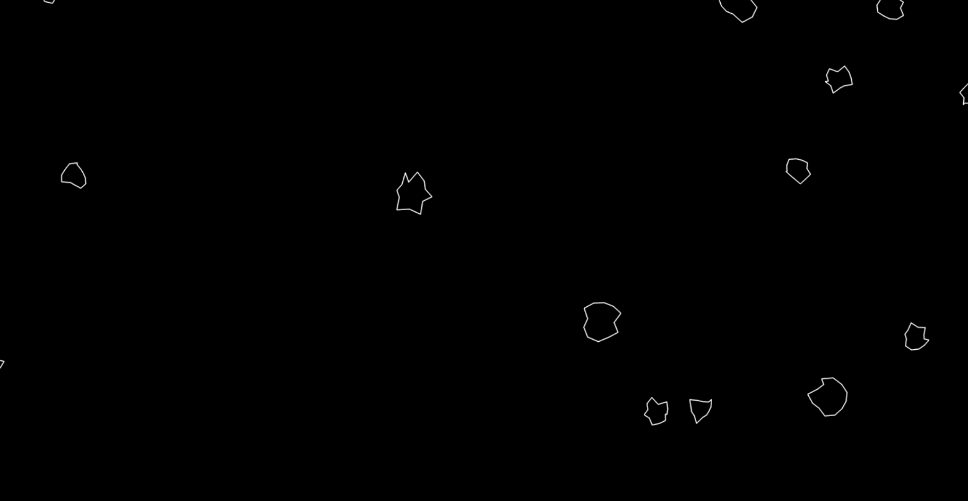
Asteroids (with added sound)

